Slide 1
ADA BOOST – REGRESSION

Slide 2
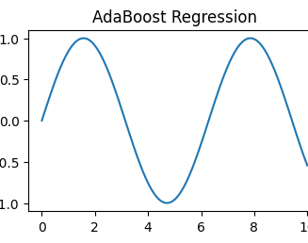
Introduction to AdaBoost Regression
AdaBoost Regression is an ensemble learning technique used for regression problems.
It combines multiple weak learners to create a strong predictive model.
The algorithm improves prediction accuracy by reducing errors iteratively.

Slide 3
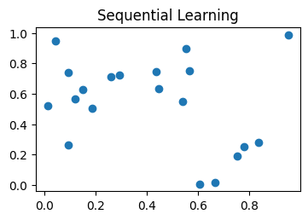
How AdaBoost Regression Works
The model trains weak regressors one after another sequentially.
Higher importance is given to data points with larger prediction errors.
Final prediction is obtained by combining outputs from all weak learners.

Slide 4
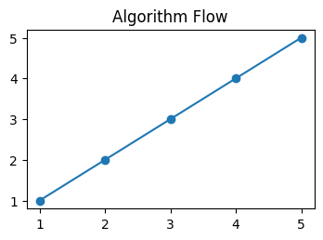
Algorithm Steps
1. Initialize sample weights
2. Train weak regressor
3. Calculate error
4. Update weights
5. Combine regressors

Slide 5
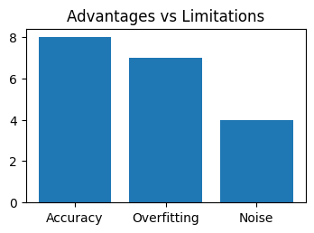
Advantages and Limitations
Advantages:
• High prediction accuracy
• Reduces overfitting
Limitations:
• Sensitive to noisy data
• Requires careful tuning

Slide 6
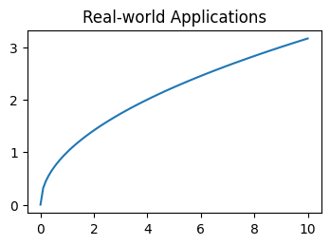
Applications of AdaBoost Regression
Used in financial forecasting and stock price prediction.
Applied in healthcare for medical data analysis and prediction.
Helpful in sales forecasting, weather prediction, and machine learning projects.

